Slide 1
Pointer Introduction
A pointer is a constant or variable that contains an address that can be used to access data. Pointers are built on the basic concept of pointer constants.
Topics discussed in this section:
Pointer Constants
Pointer Values
Pointer Variables
Accessing Variables Through Pointers
Pointer Declaration and Definition
Declaration versus Redirection
Initialization of Pointer Variables

Slide 2
Note
An address expression, one of the expression types in the unary expression category, consists of an ampersand (&) and a variable name.

Slide 3
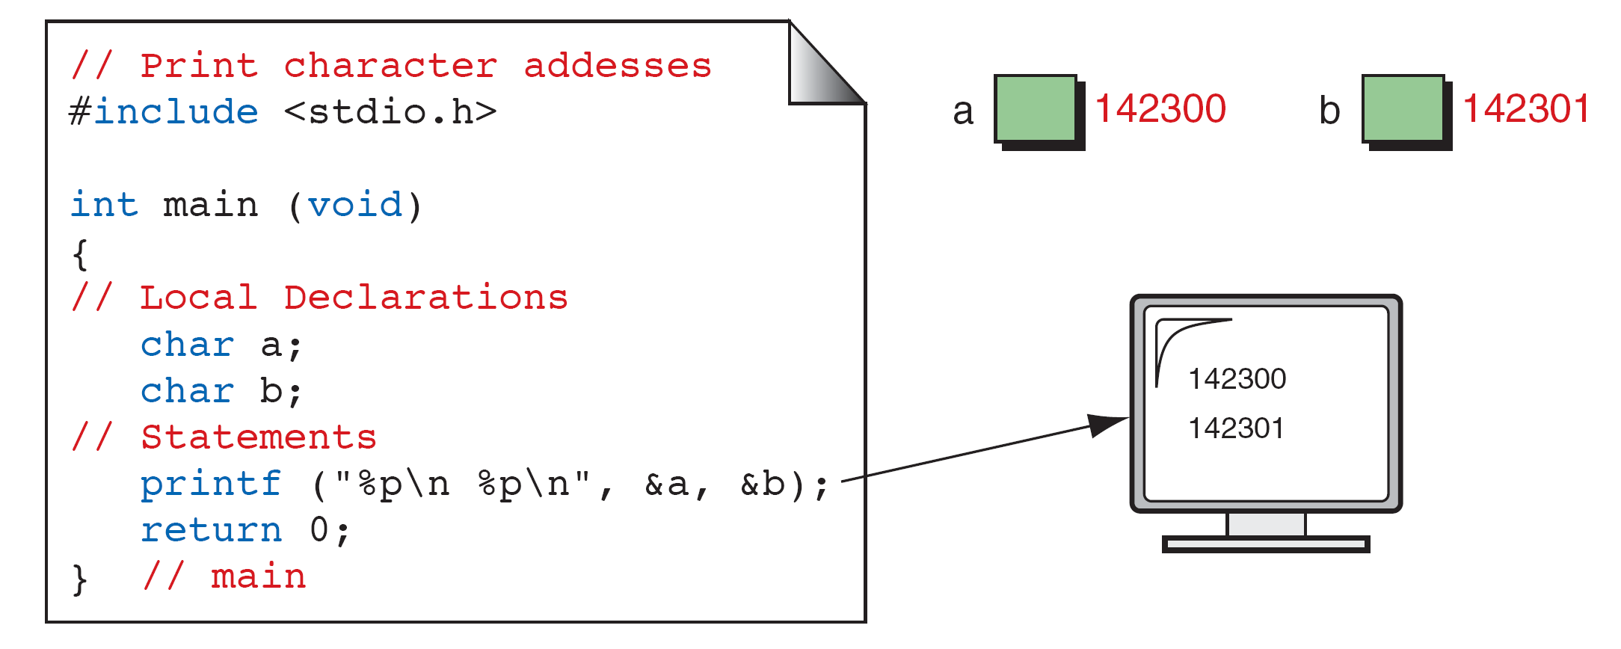
Print Character Addresses

Slide 4
Note
A variable’s address is the first byte occupied by the variable.

Slide 5
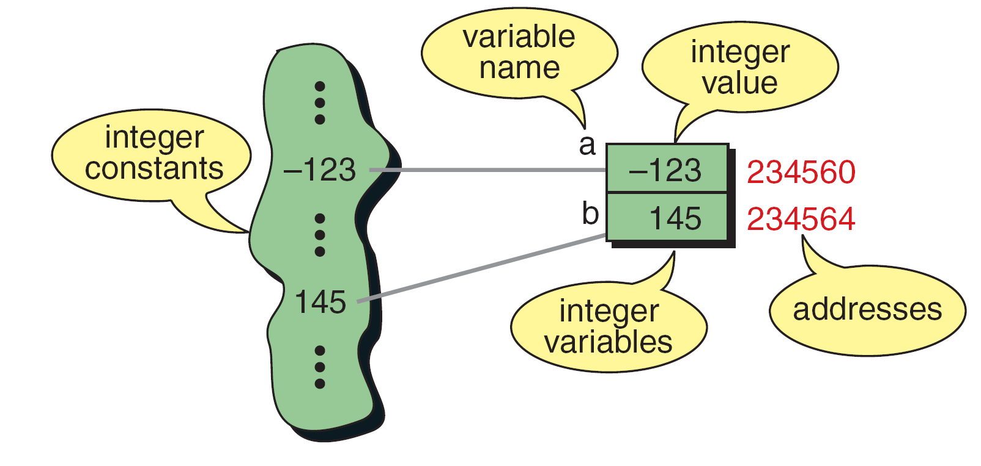
Integer Constants and Variables

Slide 6
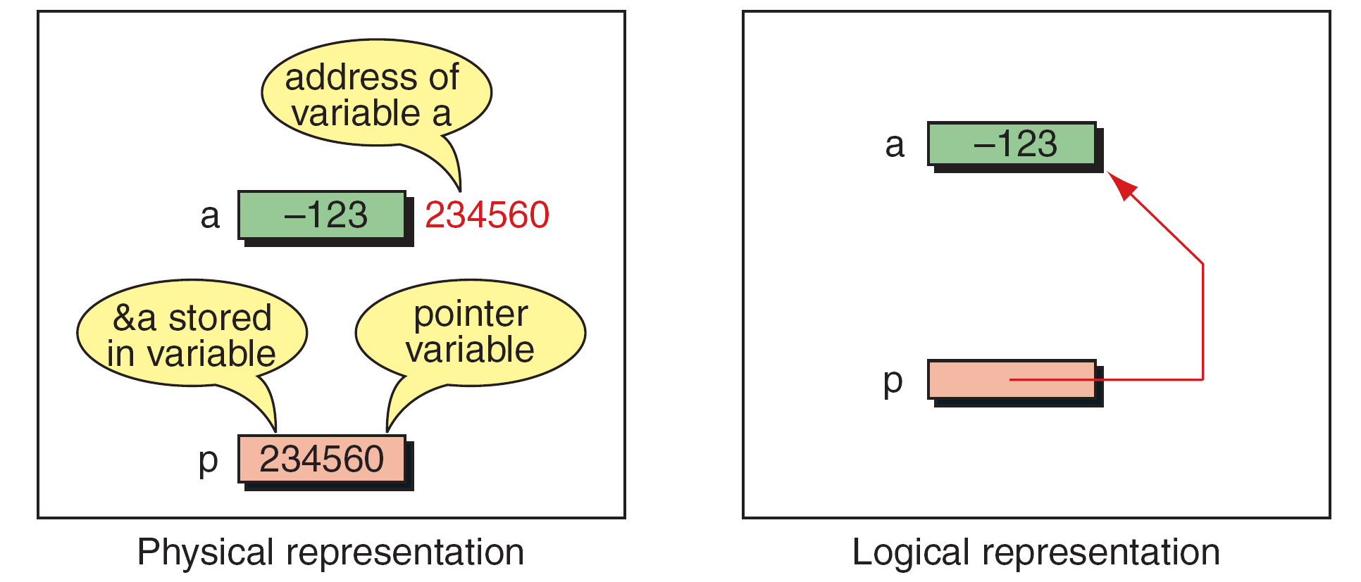
Pointer Variable

Slide 7
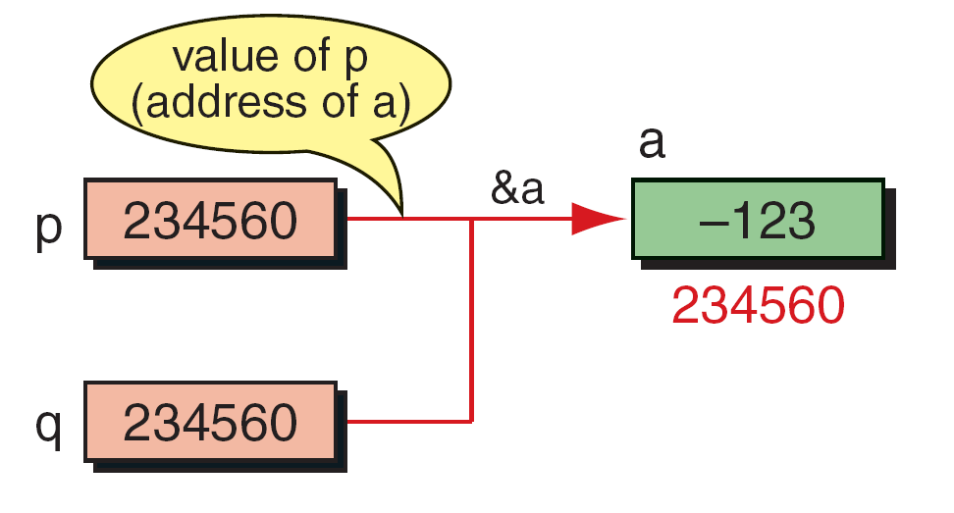
Multiple Pointers to a Variable

Slide 8
Note
A pointer that points to no variable contains the special null-pointer constant, NULL.

Slide 9
Note
An indirect expression, one of the expression types in the unary expression category, is coded with an asterisk (*) and an identifier.

Slide 10
Accessing Variables Through Pointers

Slide 11
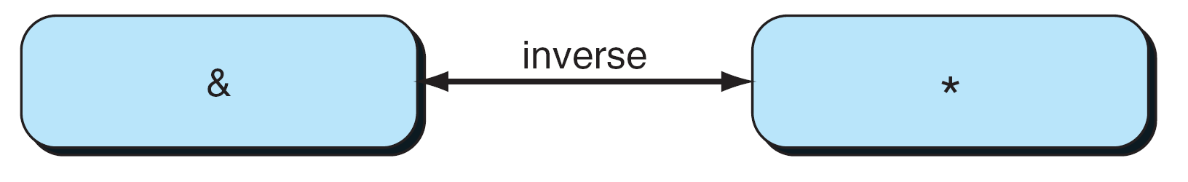
Address and Indirection Operators

Slide 12
Pointer Variable Declaration

Slide 13
Declaring Pointer Variables

Slide 14
Demonstrate Use of Pointers

Slide 15
Demonstrate Use of Pointers

Slide 16
Uninitialized Pointers

Slide 17
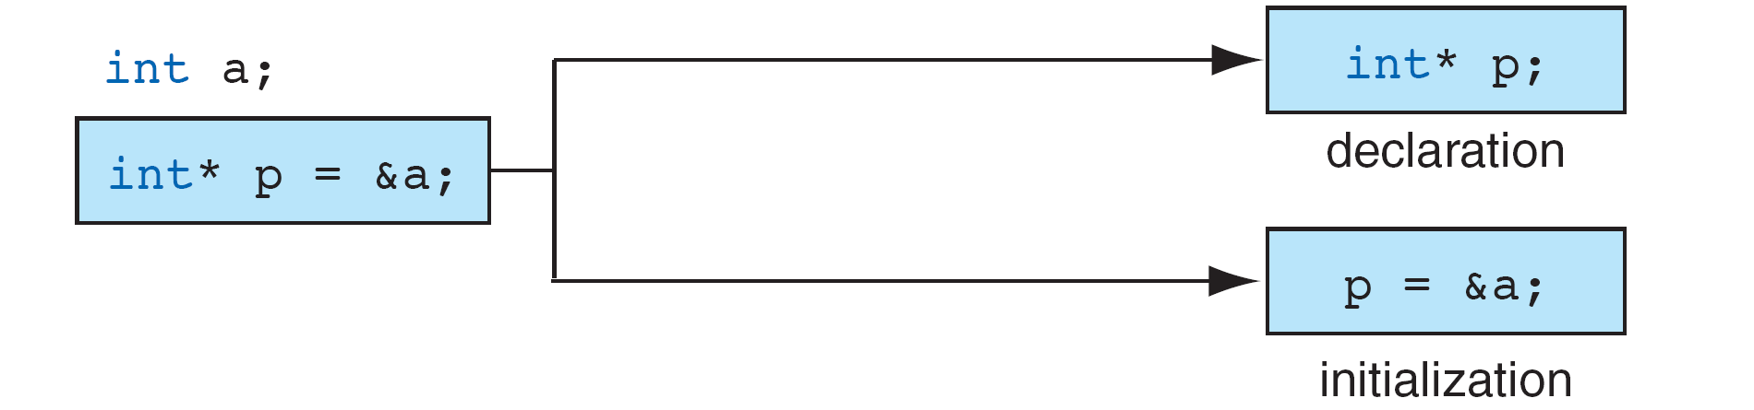
Initializing Pointer Variables

Slide 18
Fun with Pointers

Slide 19
Fun with Pointers

Slide 20
Fun with Pointers

Slide 21
Add Two Numbers Using Pointers

Slide 22
Add Two Numbers Using Pointers

Slide 23
Add Two Numbers Using Pointers

Slide 24
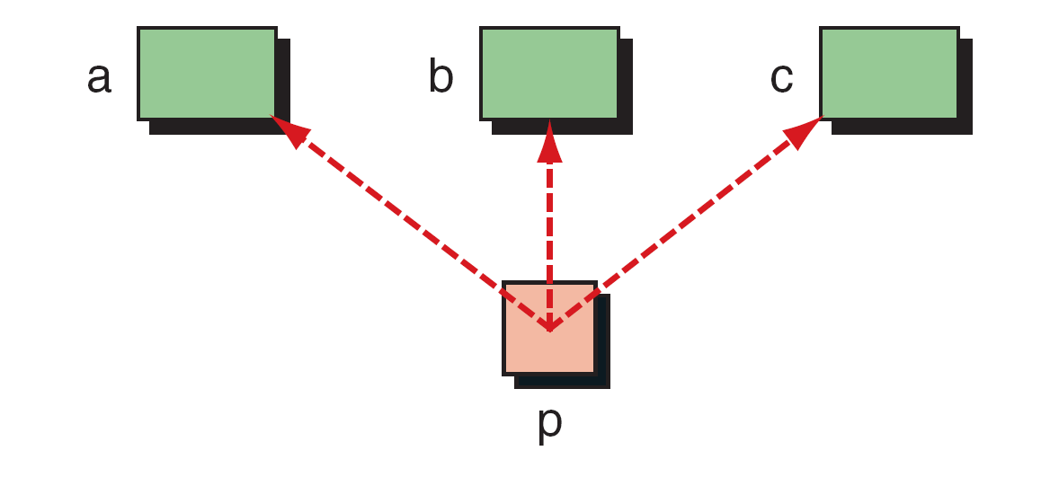
Demonstrate Pointer Flexibility

Slide 25
Using One Pointer for Many Variables

Slide 26
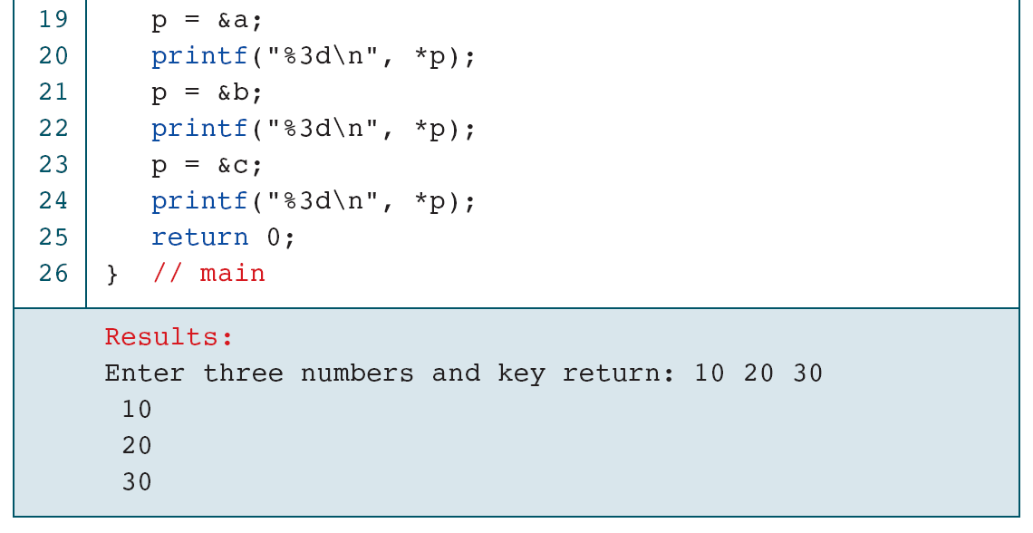
Using One Pointer for Many Variables

Slide 27
One Variable with Many Pointers

Slide 28
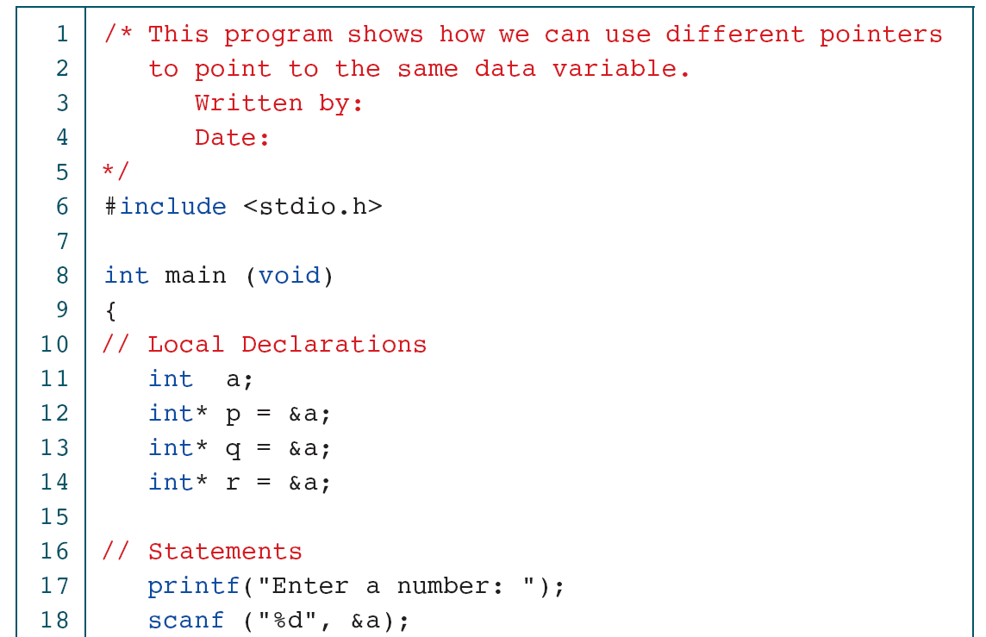
Using A Variable with Many Pointers

Slide 29
Using A Variable with Many Pointers

